Slide 1


Robust Deep Reinforcement Learning for Portfolio Management
Master of Science in Management
Presented By Amin Masoudi
Supervisors: Jonathan Patrick, Jonathan Li

Slide 2
Contents
Part One
Introduction
Part Two
Problem Definition
Part three
Methodology
Part four
Experiments
Part five
Future Works

Slide 3

Introduction
Part 1
“RL has been most successful in finance, the reason that you don’t hear about it, is because it is successful.” (Shie Mannor, 2019)

Slide 4
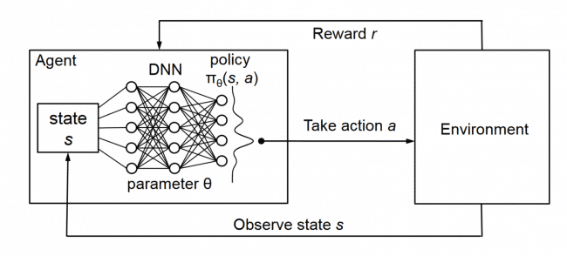
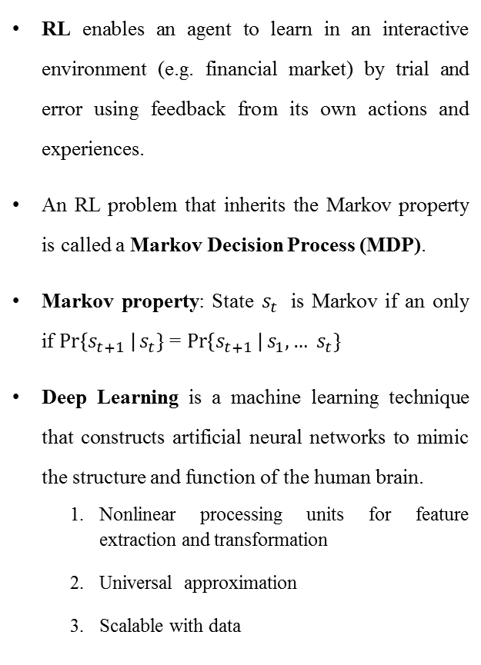
Reinforcement and Deep Learning
RL enables an agent to learn in an interactive environment (e.g. financial market) by trial and error using feedback from its own actions and experiences.
An RL problem that inherits the Markov property is called a Markov Decision Process (MDP).
Markov property: State $s_{t}$ is Markov if an only if $\operatorname{Pr}\left\{s_{t+1} \right|s_{t}\}$= $\operatorname{Pr}\left\{s_{t+1} \right|s_{1},… s_{t}\}$
Deep Learning is a machine learning technique that constructs artificial neural networks to mimic the structure and function of the human brain.
Nonlinear processing units for feature extraction and transformation
Universal approximation
Scalable with data
Source: people.csail.mit.edu/hongzi/content/publications/DeepRM-HotNets16.pdf

Slide 5
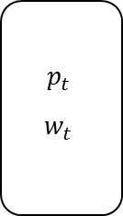

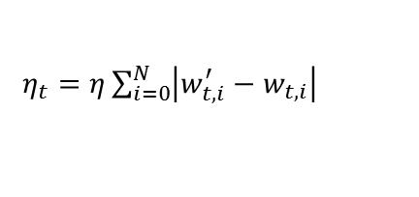
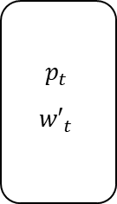


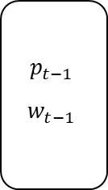






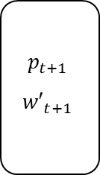




Portfolio Management
$$p_{t−1}$$
$$w_{t−1}$$
$$p_{t}$$
$${w′}_{t}$$
$$η$$
$$p_{t}$$
$$w_{t}$$
$$p_{t+1}$$
$${w′}_{t+1}$$
$$y_{t}$$
$$y_{t+1}$$
$$p_{T}=\prod_{t=1}^{T}{ }\left(1−η_{t}\right)y_{t}⋅w_{t−1}$$
…
t-1
Period t
t
Period t+1
t+1
Time
Mathematical formalism
MDP model
Portfolio
N risky assets (stocks) + 1 risk-free asset
State
Fixed window length historical relative close price ratio:
$$\sum_{i=0}^{N}{ }w_{i,t}=1$$
$$w_{t}=\left[w_{0,t},w_{1,t},⋯,w_{N,t}\right]$$
$$\overset{→}{v_{i,t}}=\left[ \begin{aligned}v_{i,t−W} \\ v_{i,t−W+1} \\ ⋮ \\ v_{i,t−1}\end{aligned} \right]$$
Portfolio vector
$$s_{t}=$$
,where $v_{i,t}$ = $\frac{v_{i,t,close }}{v_{i,t−1,close}}$
Relative price vector
$$y_{t}=\left[1 , \frac{v_{1,t,close}}{v_{1,t−1,close}} , \frac{v_{2,t,close}}{v_{2,t−1,close}} , ⋯ , \frac{v_{N,t,close}}{v_{N,t−1,close}}\right]$$
Action
Reallocation at the end of the day
$$a_{t}={ w}_{t}$$
Transaction cost
$η_{t}=η\sum_{i=0}^{N}{\left|w_{t,i}^{′}−w_{t,i}\right|}$
$$a_{t}= μ\left(s_{t}\right)$$
Policy
$$w_{t}^{′}=\frac{y_{t}⊙w_{t−1}}{y_{t}⋅w_{t−1}}$$
$$r=\frac{1}{T}\log{\prod_{t=1}^{T+1}{ }\left(1−η_{t}\right)}y_{t}⋅w_{t−1}=\frac{1}{T}\sum_{t=1}^{T}{ }\log\left(η_{t}y_{t}⋅w_{t−1}\right)$$
Weights after price movements
Reward
Assumptions
No impact on market, Zero slippage
$$\left.Q_{μ}(s,a)= E_{μ}\left[r_{t}\right|s_{t}=s , a_{t}=a\right]=$$
$$E_{μ}\left[\sum_{k=0}^{T−t−1}{γ^{k}} | r_{t+1+k} | s_{t}=s a_{t}=a\right]$$
Value Function

Slide 6
Literature Review
(Freitas et al., 2009), (Seyed Taghi Akhavan Niaki, 2013), (Luckyson Khaidem, 2016), (Heaton et al., 2016), (A Tsantekidis, 2017)
The idea is to forecast the asset’s price and then fed it to a trading module to drive desired actions
They highly depend on the degree of prediction accuracy
not fully automated
Supervised Learning
Machine learning approaches used for portfolio management
Reinforcement Learning
(J. Moody, M. S. ,2001), (Dempster, V. L. ,2006), (Deng Y, B. F. ,2017), (Cumming, 2006)
By using Direct Reinforcement
limited to single-asset trading, they do not apply to general portfolio management problems
(Zhengyao Jiang, 2017)
By using Deterministic Policy Gradients method
do not study uncertainty and how to mitigate the adverse impact of it.

Slide 7

Problem Definition
Part 2

Slide 8

The Challenge of Solving Portfolio Management Problem
The Portfolio management problem gets particularly difficult to solve when there is a need to consider multiple assets or use a longer price history of assets. In such cases, techniques such as dynamic programming will suffer from curse of dimensionality and are computationally intractable. Thus, In this thesis, we used Deep RL to overcome these challenges.

Slide 9
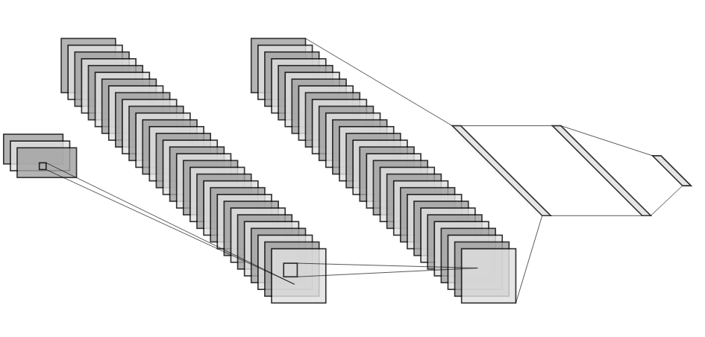
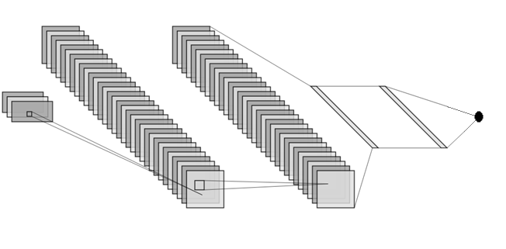
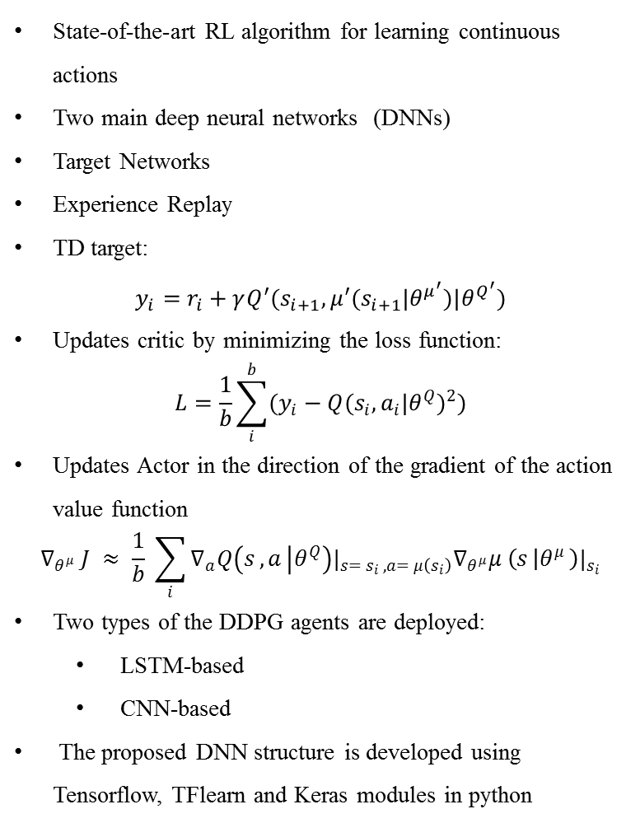

Deep Deterministic Policy Gradient
State-of-the-art RL algorithm for learning continuous actions
Two main deep neural networks (DNNs)
Target Networks
Experience Replay
TD target:
$$\begin{matrix}y_{i}=r_{i}+γQ^{′}(s_{i+1},μ^{′}(s_{i+1}|θ^{μ^{′}})|θ^{Q^{′}})\end{matrix}$$
Updates critic by minimizing the loss function:
$$L=\frac{1}{b}\sum_{i}^{b}{(y_{i}−Q(s_{i},a_{i}|θ^{Q})^{2})}$$
Updates Actor in the direction of the gradient of the action value function
$$∇_{θ^{μ}} J ≈ \frac{1}{b} \sum_{i}{∇_{a}Q\left(s_{ },a_{ } | θ^{Q}\right)|_{s= s_{i }, a= μ\left(s_{i}\right)}∇_{θ^{μ}}μ^{ }\left(s_{ } | θ^{μ^{ }}\right)|_{s_{i}}}$$
Two types of the DDPG agents are deployed:
LSTM-based
CNN-based
The proposed DNN structure is developed using Tensorflow, TFlearn and Keras modules in python
Actor Networks Structure
Convolutional layer with 32 convolutional filters of size 1x3
Convolutional layer with 32 convolutional filters of size 1x3
Input shape: (b,N+1, w, f),b is the batch size, N non-cash asset and one cash (money), w is the size of the time window of the features f. (see section 4.5)
Fully-Connected layer with 64 neurons
Fully-Connected layer with 64 neurons
Softmax layer that outputs the portfolio weight or action $a_{t}$
Critic Networks Structure
Fully-Connected layer with a single neuron that outputs a scalar value

Slide 10
Why do we need to have a robust approach?
Model is not known and created from a few samples:
Since the initial parameters for citric before any updates are random biased values, TD target is a biased estimate during training and could be misleading, especially when training the agent on a sample data for a limited time horizon.
Cost of failure is high in the practical applications of DDPG algorithm. For instance in finance, health, robotics, power grids.

Slide 11
Research Question
“How can a RL trading agent maximize portfolio return while immunizing the learning process of portfolio management from the adversarial impact due to sampling errors?”

Slide 12
Research Contribution
Making a robust automated trading agent for making investment decision with real-time price data by incorporating robust optimization with DRL algorithm (Deep Deterministic Policy Gradient) in python programming language.
The RL agent of this research is robust to the adversarial impact of sampling errors in learning the market and can offer a safer path for the investor’s portfolio value during the trading period and reduce the riskiness of the investment strategy.

Slide 13
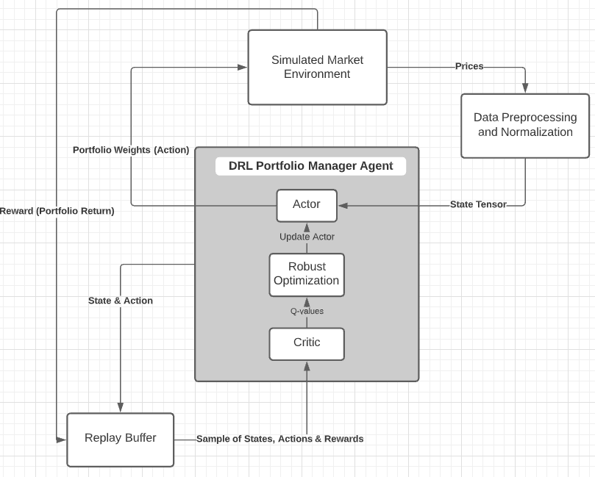

Methodology
Part 3

Slide 14
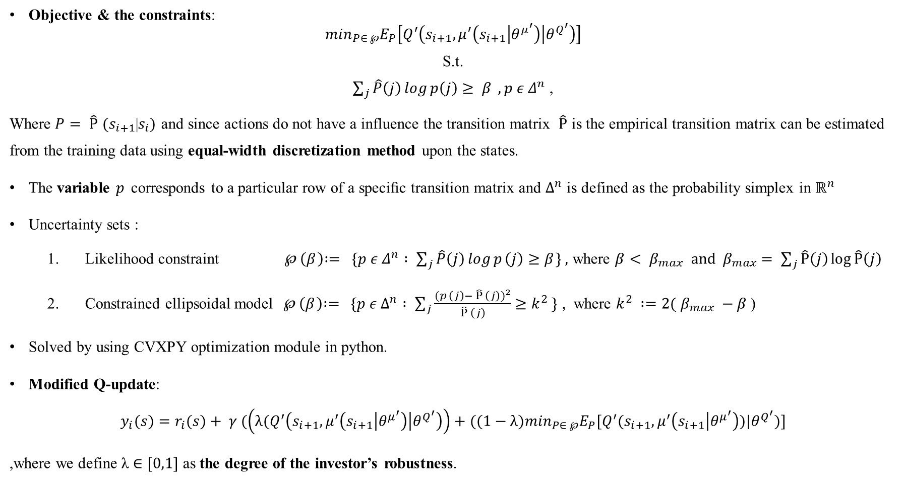
Robust Optimization And Uncertainty Sets
Here similar to (Arnab Nilim, 2005) we address the issue of uncertainty at a higher level and seek robust decisions assuming uncertain state transition probabilities:
Objective & the constraints:
$$\min_{P∈ ℘}E_{P}\left[Q^{′}\left(s_{i+1},μ^{′}\left(s_{i+1} | θ^{μ^{′}}\right) | θ^{Q^{′}}\right)\right]$$
S.t.
$\sum_{j}{\hat{Ρ}\left(j\right)\log{p\left(j\right)}≥ β} , p ε Δ^{n}$ ,
Where $P_{ }= {{\hat{Ρ}}_{ }}^{ }(s_{i+1}$|$s_{i})$ and since actions do not have a influence the transition matrix $\hat{Ρ}$ is the empirical transition matrix can be estimated from the training data using equal-width discretization method upon the states.
The variable $p_{ }$ corresponds to a particular row of a speciﬁc transition matrix and $Δ^{n}$ is defined as the probability simplex in $ℝ^{n}$
Uncertainty sets :
Likelihood constraint${ ℘}_{ }\left(β_{ }\right)∶= \{p ε Δ^{n} : \sum_{j}{{\hat{Ρ}}_{ }\left(j\right)\log{p_{ }\left(j\right)}≥β_{ }\}} ,$ where $β< β_{max} and β_{max}= \sum_{j}{\hat{Ρ}\left(j\right)\log{\hat{Ρ}\left(j\right)}}$
Constrained ellipsoidal model${ ℘}_{ }\left(β_{ }\right)∶= \{p ε Δ^{n} : \sum_{j}{\frac{{(p_{ }\left(j\right)− {\hat{Ρ}}_{ }\left(j\right))}^{2}}{{\hat{Ρ}}_{ }\left(j\right)}≥{k^{2}}_{ }\}}$ , where ${k^{2}}_{ }∶=2($ $β_{max} −β$)
Solved by using CVXPY optimization module in python.
Modified Q-update:
$$y_{i}(s)=r_{i}(s)+ γ (\left(λ{(Q}^{′}\left(s_{i+1},μ^{′}\left(s_{i+1} | θ^{μ^{′}}\right) | θ^{Q^{′}}\right)\right)+((1−λ)\min_{P∈ ℘}E_{P}[Q^{′}(s_{i+1},μ^{′}\left(s_{i+1} | θ^{μ^{′}}\right))|θ^{Q^{′}})]$$
,where we define λ $∈[0,1]$ as the degree of the investor’s robustness.

Slide 15
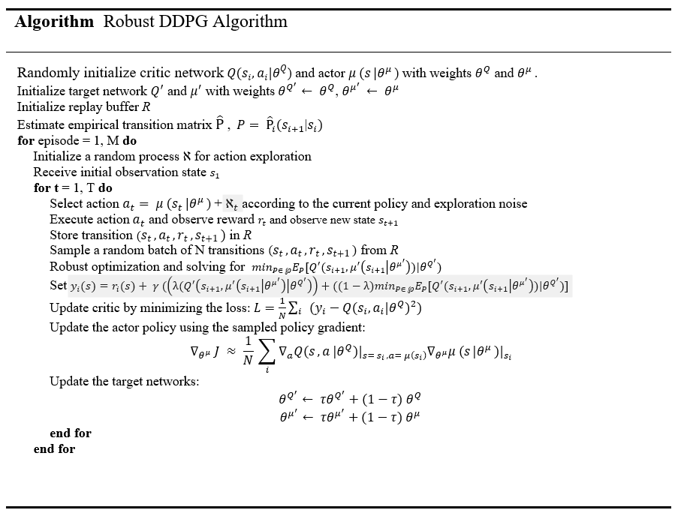
Robust Deep Deterministic Policy Gradient

Slide 16

Experiments
Part 4

Slide 17
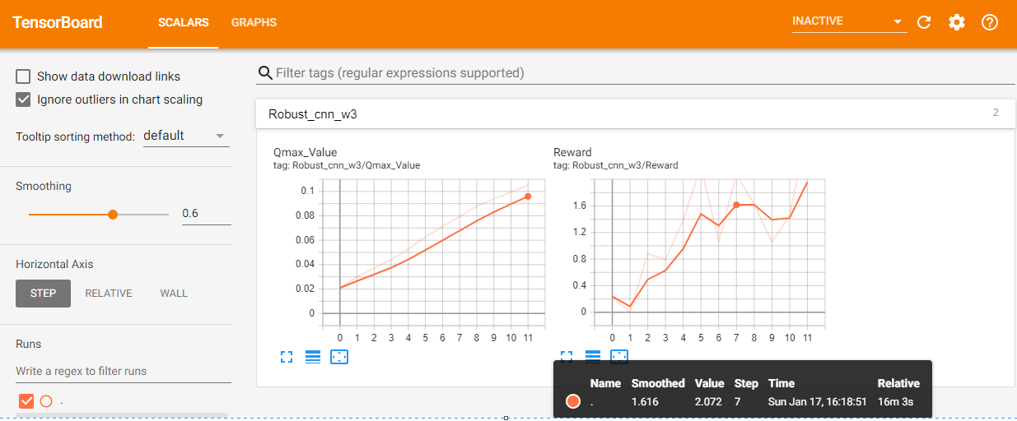
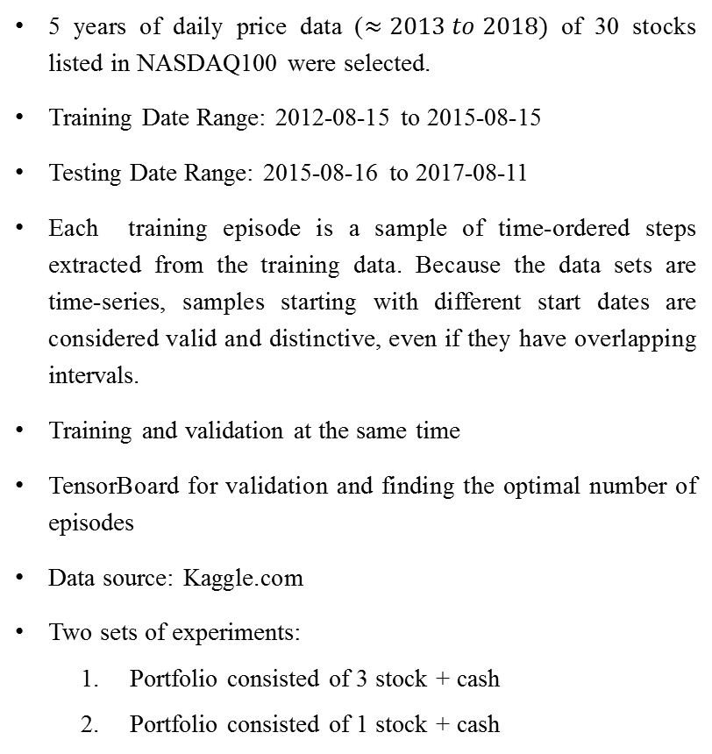
Data, Training and Validation
5 years of daily price data ($≈2013 to 2018)$ of 30 stocks listed in NASDAQ100 were selected.
Training Date Range: 2012-08-15 to 2015-08-15
Testing Date Range: 2015-08-16 to 2017-08-11
Each training episode is a sample of time-ordered steps extracted from the training data. Because the data sets are time-series, samples starting with different start dates are considered valid and distinctive, even if they have overlapping intervals.
Training and validation at the same time
TensorBoard for validation and finding the optimal number of episodes
Data source: Kaggle.com
Two sets of experiments:
Portfolio consisted of 3 stock + cash
Portfolio consisted of 1 stock + cash

Slide 18
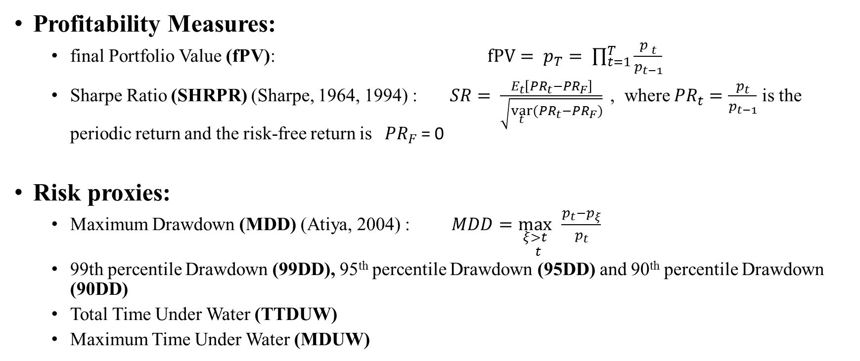
Performance Measures
Profitability Measures:
final Portfolio Value (fPV): $fPV= p_{T}= \prod_{t=1}^{T}{\frac{{p^{ }}_{t}}{p_{t−1}}}$
Sharpe Ratio (SHRPR) (Sharpe, 1964, 1994) : $SR= \frac{E_{t}\left[{PR}_{t}−{PR}_{F}\right]}{\sqrt{\underset{t}{var}{({PR}_{t}−{PR}_{F})}}}$ , where ${PR}_{t}=\frac{p_{t}}{p_{t−1}}$ is the periodic return and the risk-free return is${ PR}_{F}$ = 0
Risk proxies:
Maximum Drawdown (MDD) (Atiya, 2004) : $MDD=\underset{t}{\max_{ξ>t}{ }}\frac{p_{t}−p_{ξ}}{p_{t}}{ }{ }$
99th percentile Drawdown (99DD), 95th percentile Drawdown (95DD) and 90th percentile Drawdown (90DD)
Total Time Under Water (TTDUW)
Maximum Time Under Water (MDUW)

Slide 19
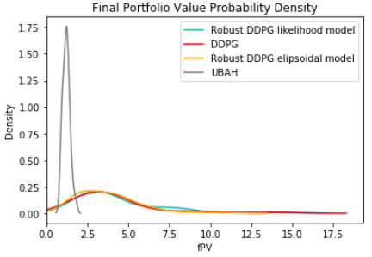
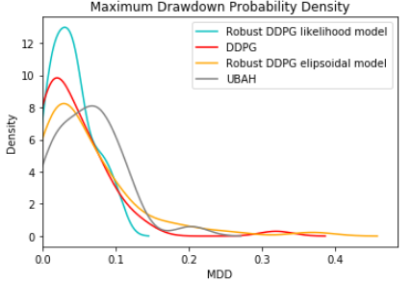
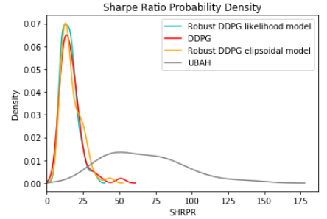
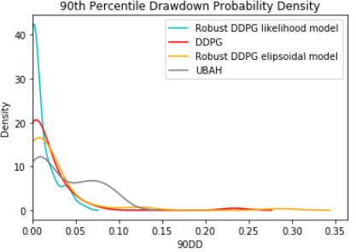
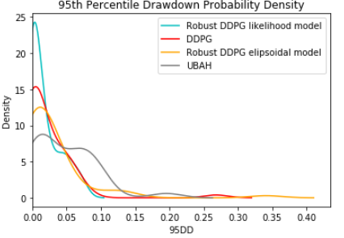
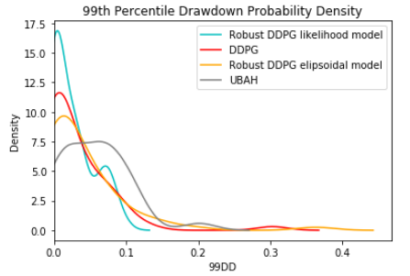
Experiment 1 Back-Test Results (Multi Stock Portfolio)
Comparing the performance of the Robust DRL vs DRL algorithms and UBAH (Uniform Buy And Hold) strategy
30 portfolio is randomly generated consisting of 3 assets and cash money and training begins
Window size is 3 days
λ is set to 0.55 & $β$ is set to$(β_{max}−0.1)$

Slide 20
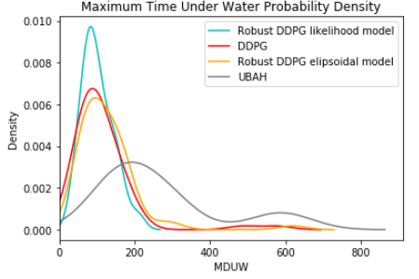
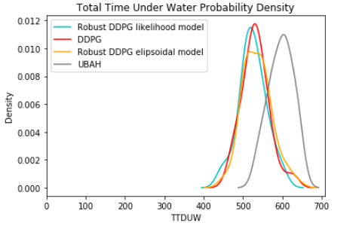

Experiment 1 Back-Test Results (Multi Stock Portfolio)
Z-Test
Testing for difference in the mean values of performance measures of robust DDPG likelihood model and DDPG (assuming a two-sided alternative hypothesis)

Slide 21
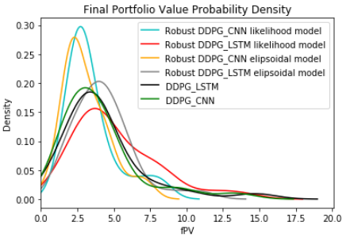
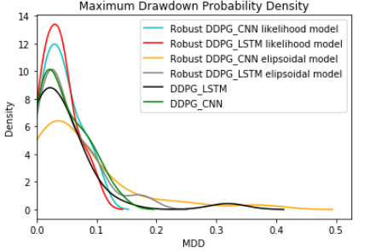
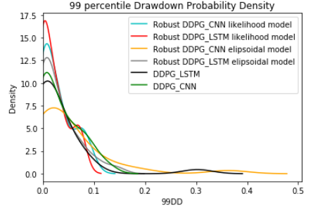
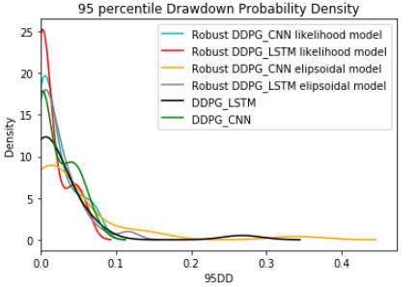
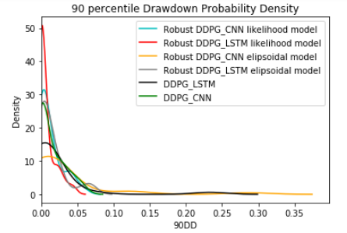
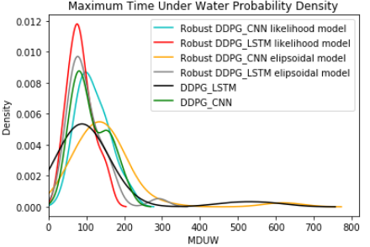
Experiment 1 Back-Test Results (Multi Stock Portfolio)

Slide 22
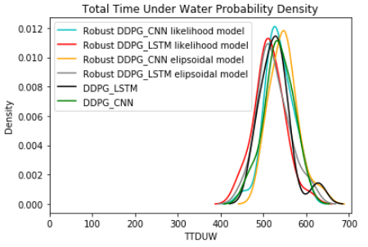
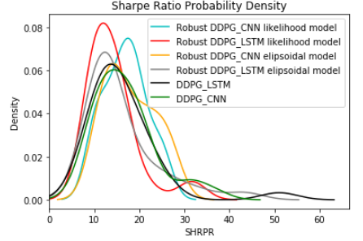

Slide 23
Experiment 2 Back-Test Results (Single Stock Portfolio)
Comparing the performance of the DRL algorithms with dynamic programming solution
30 Portfolios are randomly generated consisting of 1 asset and cash money
Window size is one day
Q-tabular learning actions are eleven discrete values {0, 0.1, 0.2, …, 1}
λ is set to 0.55 & $β$ is set to$( β_{max}−0.1)$

Slide 24
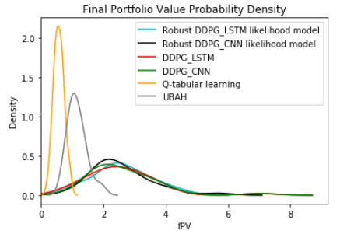
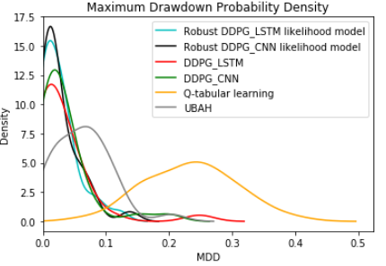
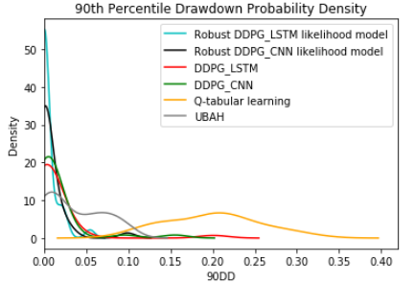
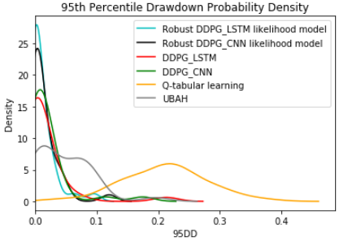
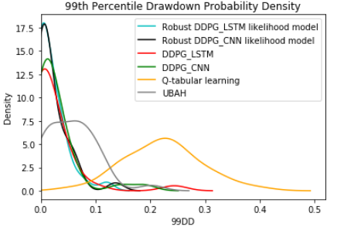
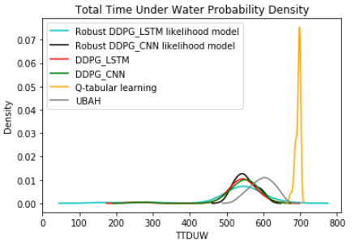
Experiment 2 Back-Test Results (Single Stock Portfolio)

Slide 25
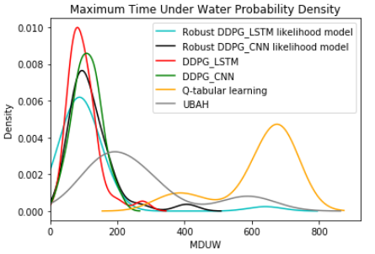

Slide 26
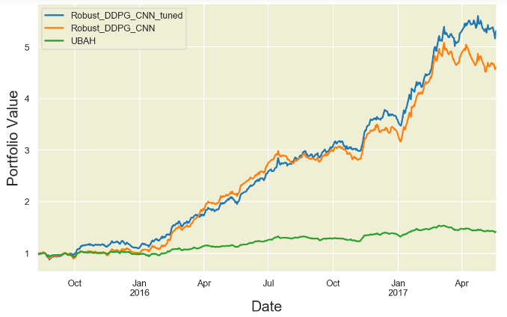
Hyperparameter tuning
Algorithm: Genetic
They imitate the biological processes of reproduction and natural selection to solve for the ‘fittest’ solutions (Goldberg, 1989)
Robust DDPG CNN after hyper-parameter optimization step where λ = 0 and β = -1
Robust DDPG CNN before hyper-parameter optimization step where λ = 0.55 and β = -2.4

Slide 27
Conclusion
Robust DDPG, can offer a safer path for the investor’s portfolio value during the trading period and a faster recovery from the drawdown period compared to the DDPG algorithm.
The robust algorithm can also offer a higher rate of return comparing to DDPG algorithm.
The robust models showed better performance than DDPG in managing a portfolio consisting of multiple stocks.
LSTM based agents had a better performance in both robust DDPG and DDPG algorithms compared to CNN agents in handling risk and final return of the investment making it more suitable for the portfolio management problem.
Using Genetic algorithm for hyperparameter tuning of robust DDPG algorithms had a significant impact on the robust model’s performance, making it a promising technique to be used in a practical application for this algorithm.

Slide 28
Thank you for your attention!

Slide 29
References
Arnab Nilim, L. E. (2005). Robust Control of Markov Decision Processes with Uncertain Transition Matrices. INFORMS.
Shie Mannor (2019). Workshop on New Directions in Reinforcement Learning and Control
J. B. Heaton, N. G. Polson, and Jan Hendrik Witte (2016). Deep learning for finance: deep portfolios. Applied Stochastic Models in Business and Industry.
Fabio D Freitas, Alberto F De Souza, and Ailson R de Almeida (2008). Prediction-based portfolio optimization model using neural networks. Neurocomputing.
A Tsantekidis, N. P. (2017). Forecasting stock prices from the limit order book using convolutional neural networks. IEEE 19th Conference on Business Informatics.
Luckyson Khaidem, S. S. (2016). Predicting the direction of stock market prices using random forest.
Seyed Taghi Akhavan Niaki, S. H. (2013). Forecasting S&P 500 index using artificial neural networks and design of experiments. Journal of Industrial Engineering International.
Atiya, M. M.-I. (2004). Maximum drawdown. Risk Magazine.
Sharpe, W. F. (1964). Capital asset prices: A theory of market equilibrium under conditions of risk. The journal of finance.
Sharpe, W. F. (1994). The sharpe ratio. The journal of portfolio management.
Zhengyao Jiang, D. X. (2017). A Deep Reinforcement Learning Framework for the Financial Portfolio Management Problem.

